Slide 1
Chronic Renal Failure
A. Definitions
  Azotemia - elevated blood urea nitrogen (BUN >28mg/dL) and creatinine (Cr>1.5mg/dL)
  Uremia - azotemia with symptoms or signs of renal failure
  End Stage Renal Disease (ESRD) - uremia requiring transplantation or dialysis
  Chronic Renal Failure (CRF) - irreversible kidney dysfunction with azotemia >3 months
  Creatinine Clearance (CCr) - the rate of filtration of creatinine by the kidney (GFR marker)
  Glomerular Filtration Rate (GFR) - the total rate of filtration of blood by the kidney

Slide 2
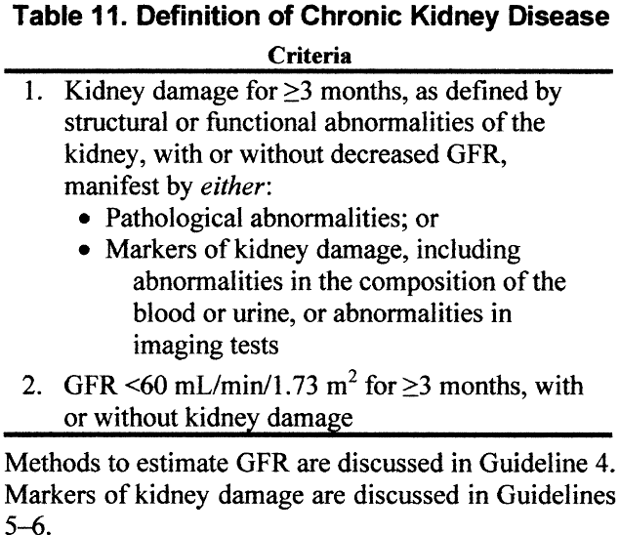

Slide 3
B. Etiology
Episodes of ARF (usually acute tubular necrosis) often lead, eventually, to CRF
Over time, combinations of acute renal insults are additive and lead to CRF
The definition of CRF requires that at least 3 months of renal failure have occurred
Causes of Acute Renal Failure (ARF)
a. Prerenal azotemia - renal hypoperfusion, usually with acute tubular necrosis
b. Intrinsic Renal Disease, usually glomerular disease
c. Postrenal azotemia - obstruction of some type

Slide 4
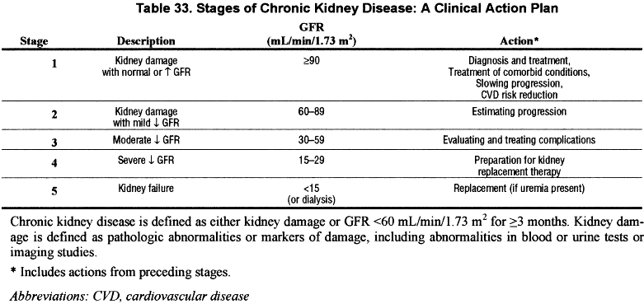

Slide 5
Common Underlying Causes of CRF
There are about 50,000 cases of ESRD per year
Diabetes: most common cause ESRD (risk 13x )
Over 30% cases ESRD are primarily to diabetes
CRF associated HTN causes @ 23% ESRD cases
Glomerulonephritis accounts for ~10% cases
Polycystic Kidney Disease - about 5% of cases
Rapidly progressive glomerulonephritis (vasculitis) - about 2% of cases
Renal (glomerular) deposition diseases
Renal Vascular Disease - renal artery stenosis, atherosclerotic vs. fibromuscular

Slide 6
Medications - especially causing tubulointerstitial diseases (common ARF, rare CRF)
Analgesic Nephropathy over many years
Pregnancy - high incidence of increased creatinine and HTN during pregnancy in CRF
6.Black men have a 3.5-4 fold increased risk of CRF compared with white men
Blood pressure and socioecomonic status correlated with CRF in whites and blacks
Unclear if blacks have increased risks when blood pressure and income are similar

Slide 7
7. Analgesic Nephropathy
Slow progression of disease due to chronic daily ingestion of analgesics
Drugs associated with this entity usually contain two antipyretic agents and either caffeine or codeine
More common in Europe and Australia than USA
Polyuria is most common early symptom
Macroscopic hematuria / papillary necrosis
Chronic interstitial nephritis, renal papillary necrosis, renal calcifications
Associated with long-term use of non-steroid anti-inflammatory drugs

Slide 8

7. Analgesic Nephropathy cont’d
Patients at risk:
DM, CHF, CRI, Hepatic disease, elderly, etc
?pathophysiology-nonselective NSAIDS inhibit synthesis vasodilatory prostaglandin in the kidney=prerenal state ARF
COX2 not so innocent afterall.

Slide 9
Electrolyte Abnormalities
Excretion of Na+ is initially increased, probably due to natriuretic factors
As glomerular filtration rate (GFR) falls, FeNa rises
Maintain volume until GFR <10-20mL/min, then edema
Renal failure with nephrotic syndrome, early edema
Cannot conserve Na+ when GFR <25mL/min, and FeNa rises with falling GFR
3. Tubular K+ secretion is decreased
Aldosterone mediated. Also increased fecal loss of K+ (up to 50% of K ingested)
Cannot handle bolus K+, avoid drugs high K+
Do not use K+ sparing diuretics

Slide 10
Control of acids
Normally, produce ~1mEq/kg/day H+
When GFR <40mL/min then decrease NH4+ excretion adds to metabolic acidosis
When GFR <30mL/min then urinary phosphate buffers decline and acidosis worsens
Bone CaCO3 begins to act as the buffer and bone lesions result (renal osteodystrophy)
Usually will not have wide anion gap even with acidosis if can make urine
Acidosis caused by combination hyperchloremia and hypersulfatemia
Defect in renal generation of HCO3-, as well as retention of nonvolatile acids

Slide 11
5. Loss of urine diluting and concentrating abilities
Osmotic diuresis due to high solute concentration for each functioning nephron
Reduce urinary output only by reducing solute excretion
Major solutes are salt and protein, so these should be decreased

Slide 12
Bone Metabolism
↓GFR leads to ↑ phosphate ↓ calcium + acidosis
In addition,↑ tubular resorption Ca+ ↑ hypocalcemia
Other defects include acidosis and decreased dihydroxy-vitamin D production
Bone acts as a buffer for acidosis, leading to chronic bone loss in renal failure
Low vitamin D causes poor calcium absorbtion and hyperparathyroidism (high PTH)
Increased PTH maintains normal serum Ca2+ and PO42- until GFR <30mL/min
Chronic hyperparathyroidism and bone buffering of acids leads to severe osteoporosis

Slide 13
7. Other abnormalities
Slight hypermagnesemia with inability to excrete high magnesium loads
Uric acid retention occurs with GFR <40mL/min
Vitamin D conversion to dihydroxy-Vitamin D is severely decreased
Erythropoietin (EPO) levels fall and anemia develops
8. Accumulation of normally excreted substances, "uremic toxins", MW 300-5000 daltons

Slide 14
Uremic Syndrome
Symptomatic azotemia
Fever, Malaise
Anorexia, Nausea
Mild neural dysfunction
Uremic pruritus

Slide 15
Associated Problems and Treatment
Immunosuppression
Patients with CRF, even pre-dialysis, are at increased risk for infection
Cell mediated immunity is particularly impaired
Hemodialysis seems to increase immunocompromise
Complement system is activated during hemodialysis
Patients with CRF should be vaccinated aggressively

Slide 16
Anemia
Due to reduced erythropoietin production by kidney
Occurs when creatinine rises to >2.5-3mg/dL
Anemia management: Hct goal @ 33%
Hyperphosphatemia
Decreased excretion by kidney
Increased phosphate load from bone metabolism (by high parathyroid hormone levels)
Increased PTH levels leads to renal bone disease
Eventually, parathyroid gland hyperplasia occurs
Danger of calciphylaxis (Ca x Phosp product)

Slide 17
  Hypertension
  Blood pressure control is very important to slowing progression of renal failure
  About 30% of end-stage renal disease (ESRD) is related to hypertension
  Overall risk of CRF with creatinine >2.0mg/dL is ~2X in five years with HTN
  Patients with grade IV (severe) HTN have 22X increased risk vs. normal for CRF
  Targetted mean pressure 92-98mm Hg in patients with renal failure and proteinuria
  Patients with HTN and albuminuria >1gm/day, blacks, diabetics have higher ESRD risk

Slide 18
  g. ACE inhibitors shown be most effective at preserving renal function by preferential dilation efferent arterioles which IGCP.
  h. ACE inhibitors are avoided in patients with serum creatinine >2.5-3mg/dL ????????
When should ACE be stopped?? Rise in Scr after ACE?? Why? Hemodynamically GFR but renoprotective. Withdraw if sustained Hyperkalemia ARB vs ACE??
Goal B/P 130/80 mmHg for all renal patients.
African American study of kidney disease (AASK), ACE >>BB or CCB
Heart Outcome Prevention and evaluation study (HOPE), ramipril dec mobidity/mortality.
Less hyperkalemia with ARB vs ACE.

Slide 19
6. Poor coagulation
Platelet dysfunction - usually with prolonged bleeding times
May be partially reversed with DDAVP administration
7. Proteinuria >0.25gm per day is an independent risk factor for renal decline]
8. Uremic pruritus may respond to dialysis or opiate antagonists (eg. naltrexone 50mg/d)

Slide 20
F. Evaluation
Search for underlying causes (see above)
Laboratory
Full Electrolyte Panel
Calcium, phosphate, uric acid, magnesium and albumin
Urinalysis, microscopic exam, quantitation of protein in urine (protein:creatinine ratio)
Calculation of creatinine clearance and protein losses
Complete blood count
Consider complement levels, protein electrophoresis, antinuclear antibodies, ANCA
Renal biopsy - particularly in mixed or idiopathic disease

Slide 21
3. Radiographic Evaluation
Renal Ultrasound - evaluate for obstruction, stones, tumor, kideny size, chronic change
Duplex ultrasound or angiography or spiral CT scan to evaluate renal artery stenosis
MRA preferred over contrast agents
4. Bone Evaluation
Severe secondary hyperparathyroidism can lead to osteoporosis
Some patients will require parathyroidectomy to help prevent this
Unclear when bone densitometry should be done on patients with CRF

Slide 22
Pre-Dialysis Treatment
Maintain normal electrolytes
Potassium, calcium, phosphate are major electrolytes affected in CRF
ACE inhibitors may be acceptable in many patients with creatinine >3.0mg/dL
ACE inhibitors may slow the progression of diabetic and non-diabetic renal disease [13]
Reduce or discontinue other renal toxins (including NSAIDS)
Diuretics (eg. furosemide) may help maintain potassium in normal range
Renal diet including high calcium and low phosphate

Slide 23
Reduce protein intake to <0.6gm/kg body weight
Appears to slow progression of diabetic and non-diabetic kideny disease
In type 1 diabetes mellitus, protein restriction reduced levels of albuminuria
Low protein diet did not slow progression in children with CRF
Underlying Disease
Diabetic nephropathy should be treated with ACE inhibitors until creatinine >2.5-3mg/dL
Hypertension should be aggressively treated (ACE inhibitors are preferred)

Slide 24
Caution with use of ACE inhibitors in renal artery stenosis
Ramipril in Non-Diabetic Proteinuric Nephropathy
Ramipril is a second generation ACE inhibitor with efficacy in HTN and heart Failure
In patients with non-diabetic proteinuria >3gm/day, ramipril reduced progression
Drug was titrated to a diastolic BP under 90mmHg
Ramipril reduced rate of GFR decline by >20%, more than anti-hypertensive drugs alone
Data for patients with <3gm/day proteinuria is still being evaluated

Slide 25
Ramipril may be preferred agent for treatment of non-diabetic proteinuric nerphropathy
A meta-analysis of ACE inhibitors in non-diabetic renal disease showed benefit
H. Hemodialysis
Indications
Uremia - azotemia with symptoms and/or signs
Severe Hyperkalemia
Volume Overload - usually with congestive heart failure (pulmonary edema)
Toxin Removal - ethylene glycol poisoning, theophylline overdose, etc.
An arterio-venous fistula in the arm is created surgically
Catheters are inserted into the fistula for blood flow to dialysis machine

Slide 26
Procedure for Chronic Hemodialysis
Blood is run through a semi-permeable filter membrane bathed in dialysate
Composition of the dialysate is altered to adjust electrolyte parameters
Electrolytes and some toxins pass through filter
By controlling flow rates (pressures), patient's intravascular volume can be reduced
Most chronic hemodialysis patients receive 3 hours dialysis 3 days per week

Slide 27
Efficacy
Some acids, BUN and creatinine are reduced
Phosphate is dialyzed, but quickly released from bone
Very effective at reducing intravascular volume/potassium
Once dialysis is initiated, kidney function is often reduced
Not all uremic toxins are removed and patients generally do not feel "normal"
Response of anemia to erythropoietin is often suboptimal with hemodialysis

Slide 28
Chronic Hemodialysis Medications
Anti-hypertensives - labetolol, CCB, ACE inhibitors
Eythropoietin (Epogen®) for anemia in ~80% dialysis pts
Vitamin D Analogs - calcitriol given intravenously
Calcium carbonate or acetate to  phosphate and PTH
RenaGel, a non-adsorbed phosphate binder, is being developed for hyperphosphatemia
DDAVP may be effective for patients with symptomatic platelet problems

